Slide 1
Find Out

Slide 2
Learning intentions
For students to
Identify what they know and what they need to find out to respond to the inquiry question
Gather information and data from primary and secondary sources
Produce a concept map to visualise research findings

Slide 3
Inquiry Question:
How can the Western Treatment Plant help Melbourne to thrive and adapt to an uncertain future?

Slide 4
Inquiry question
How can the Western Treatment Plant help Melbourne to thrive and adapt to an uncertain future?
What do I know about sewage, recycled wastewater and the Western Treatment Plant? | What do I need to find out? | What have I learnt?

Slide 5
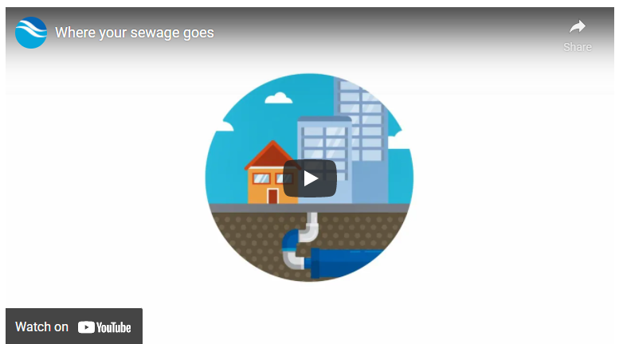
Find out: What is sewage?
Read and watch Where your sewage goes | Melbourne Water.
Fill out the KFL Chart.
WTP Virtual Tour resource

Slide 6
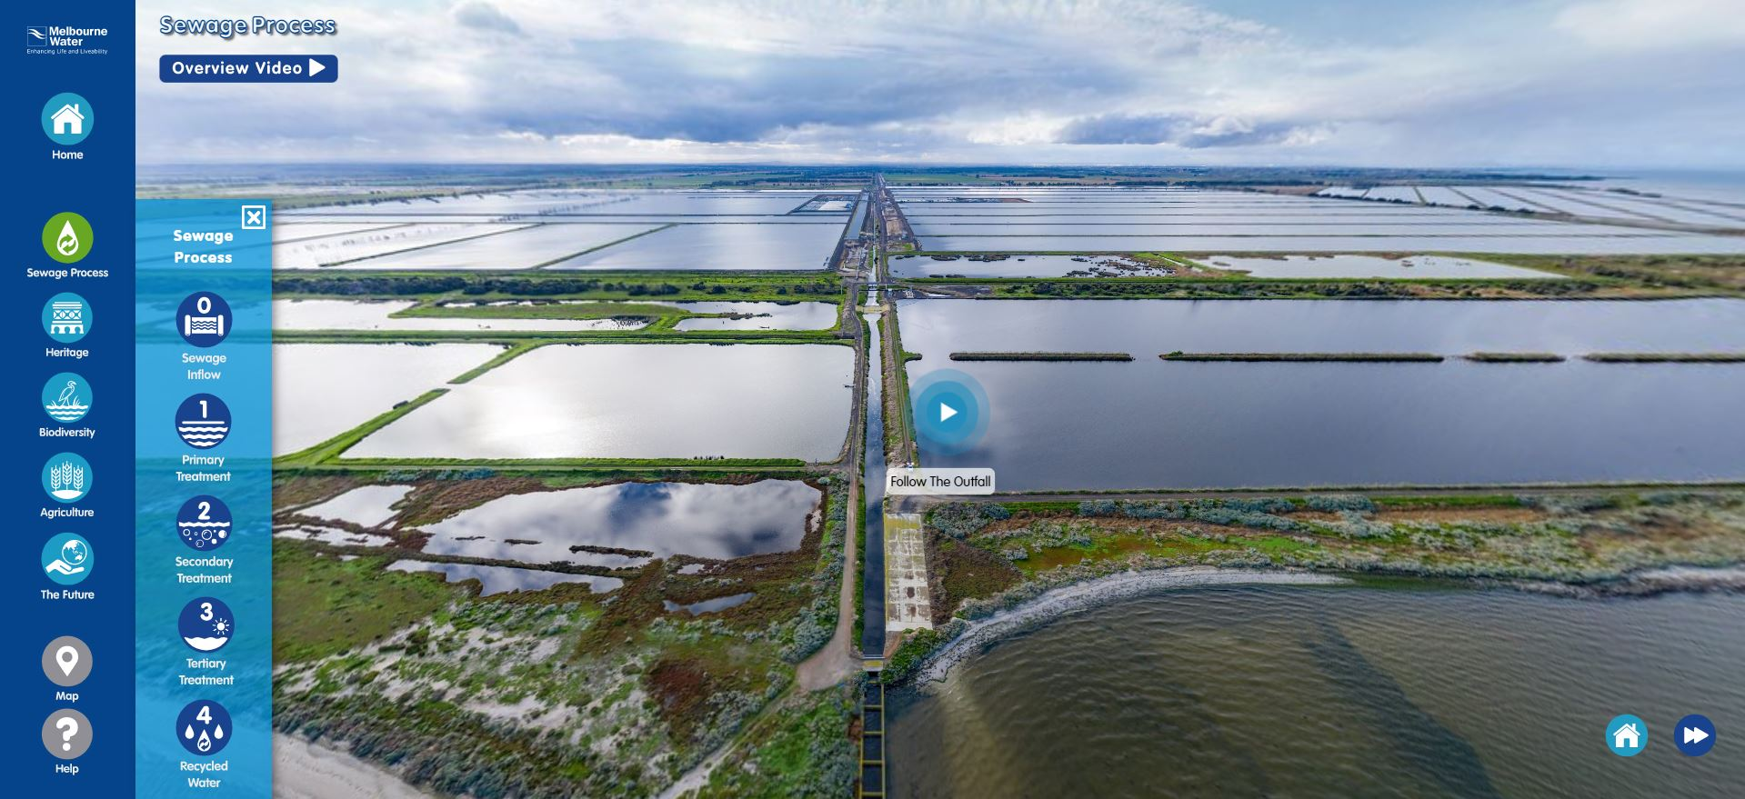
Find out: How is sewage treated at the WTP and recycled water produced
Take a virtual tour of the Western Treatment Plant and follow the Sewage Process
Fill out the KFL Chart.

Slide 7
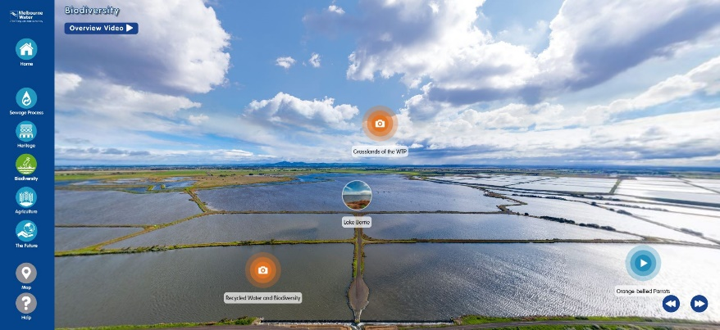
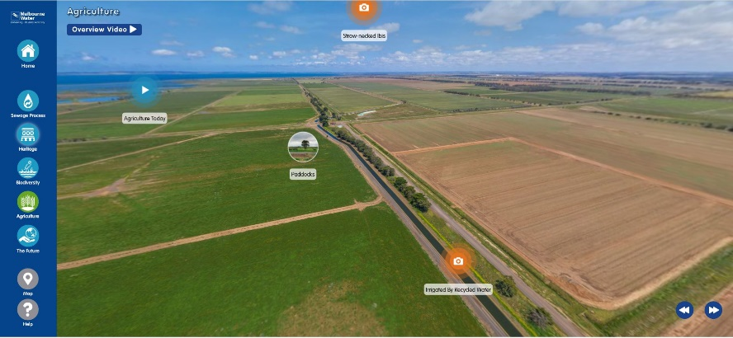
Find out: The how, where and why of recycled water
Take a virtual tour of the Western Treatment Plant and check out ‘Agriculture’ and ‘Biodiversity’.
Watch the overview videos and tour the locations.
Fill out the KFL Chart.

Slide 8
Find out more information
How is sewage treated and processed at the WTP? | Text Western Treatment Plant sewage treatment process | Melbourne Water Learning resource Cleaning up sewage (Years 9-10) | Melbourne Water
What can recycled water be used for? | Learning resource Producing recycle water Text How we're taking action | Melbourne Water
WTP Virtual Tour resource
8

Slide 9
Task: Primary data collection
Find out what Melbournians think about recycled water.
Use the following documents to plan and undertake the survey.
WTP Survey Task Instructions
WTP Rubric Survey

Slide 10
What did I find out
Task: In groups, students produce a hexagon concept map to demonstrate what they have found out about the inquiry question:
How can the Western Treatment Plant help Melbourne to thrive and adapt to an uncertain future?
The diagram should show links between inputs, processes and outcomes but also link to impacts and stakeholders.
Groups receive a sheet of hexagonal tiles for each person in the group, or a file with a digital template, and a large sheet of paper to stick the tiles to. Students fill each tile with a keyword, fact or statement and decide how to arrange the tiles to build a web of connections. Each hexagon can connect to up to six others and students should keep rearranging until they feel they’ve created the strongest web of connected ideas.
For more information on using Hexagonal planning see Learning activities

